Slide 1
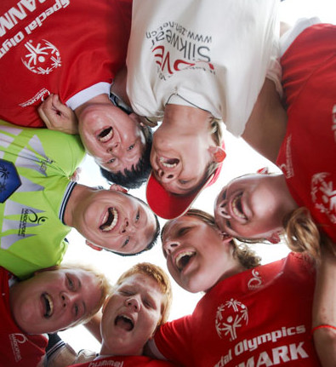

JENNIFER NEWBURY
Curriculum & Education Resource Manager,
Special Olympics
September 2010

Slide 2
Content of PowerPoint
Background on Special Olympics
Overview of Project UNIFY
Introduction of Get Into It curriculum and e-tools
Teacher Resources (Intro to Service Learning)
Program Impact
Testimonials
2

Slide 3
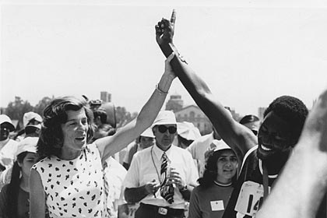
Special Olympics
Background
3

Slide 4
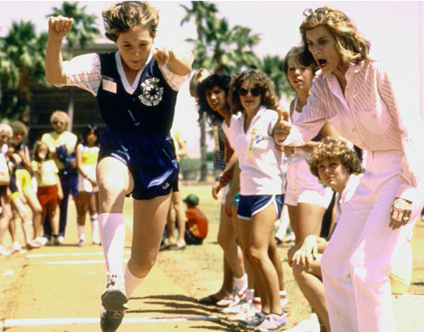
ONE WOMAN’S VISION
Eunice Kennedy Shriver changed the world for the better like few others in history. With a vision all her own, she saw beyond every horizon to create new opportunities for people with intellectual disabilities.
Founded in 1968 by Eunice Kennedy Shriver, Special Olympics provides people with intellectual disabilities continuing opportunities to realize their potential, develop physical fitness, demonstrate courage and experience joy and friendship.
4

Slide 5
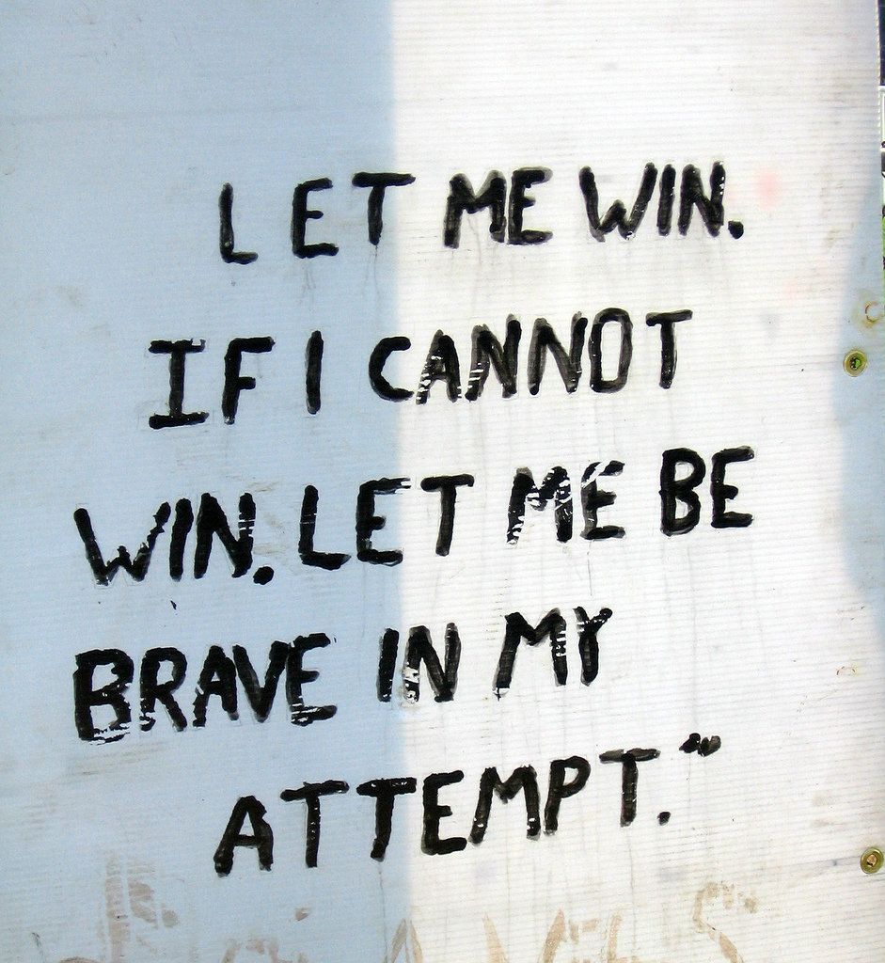
THE MISSION OF SPECIAL OLYMPICS
To provide year-round sports training and athletic competition in a variety of Olympic-type sports for children and adults with intellectual disabilities, giving them continuing opportunities to develop physical fitness, demonstrate courage, experience joy and participate in a sharing of gifts, skills and friendship with their families, other Special Olympics athletes and the community.
5

Slide 6
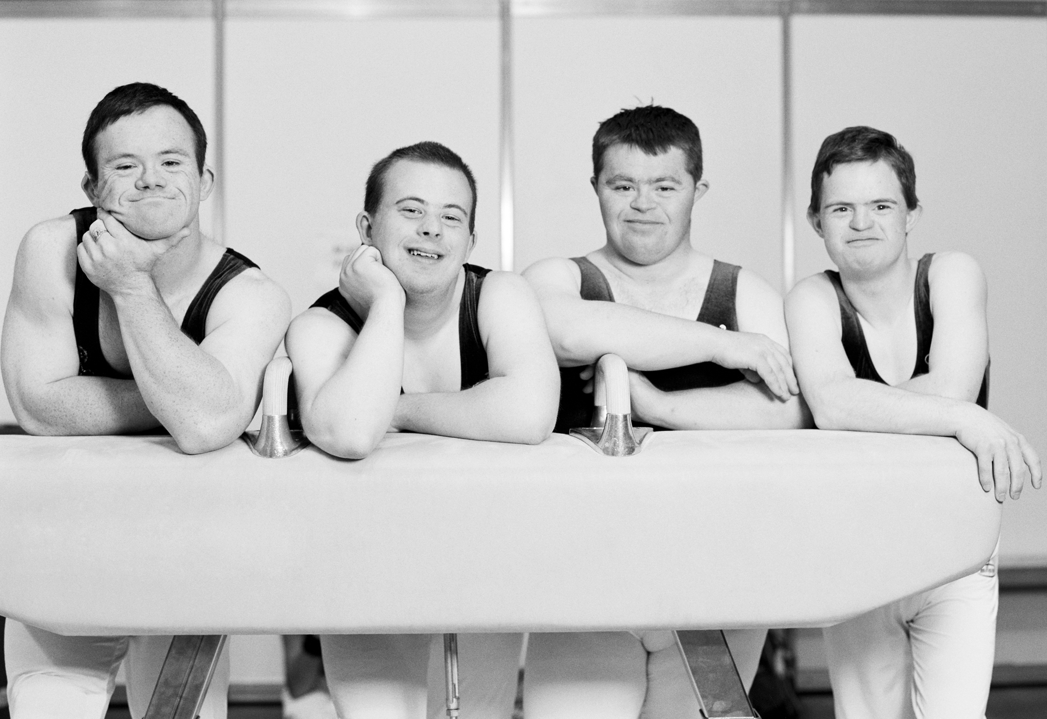
THE NEED
Approximately 2% of the global population or almost 200 million people have intellectual disabilities, making it one of the largest disability populations in the world.
6

Slide 7
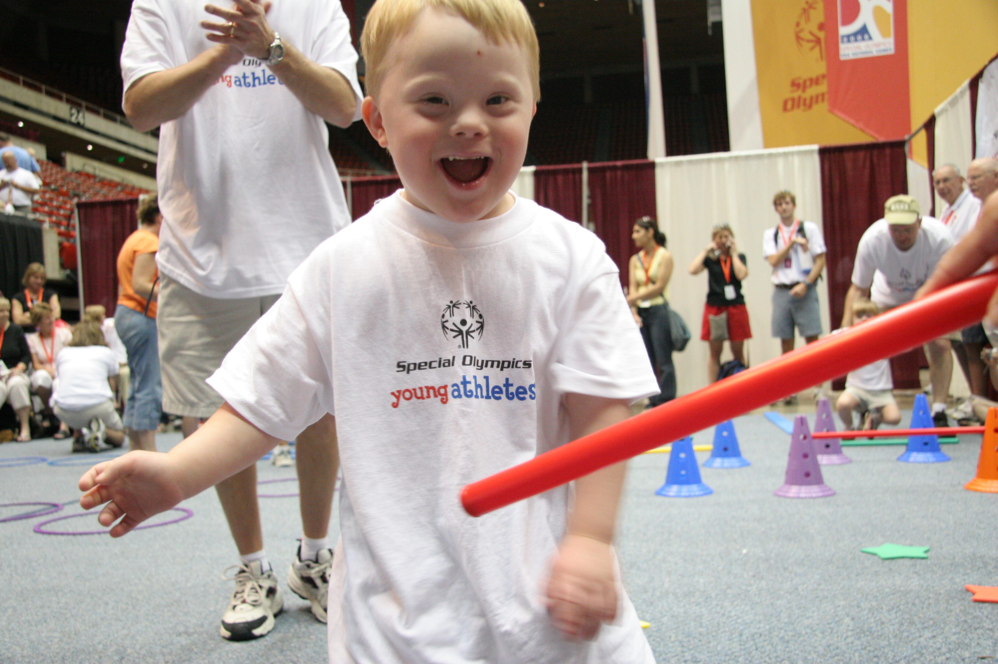
DEFINING INTELLECTUAL DISABILITY
Intellectual disability is characterized by a significant cognitive impairment combined with limitations in the adaptive skills needed to live, work and play in the community.
Harris, James C. 2006.
Intellectual disability: understanding its development, causes,
classification, evaluation, and treatment. Oxford University Press.
7

Slide 8
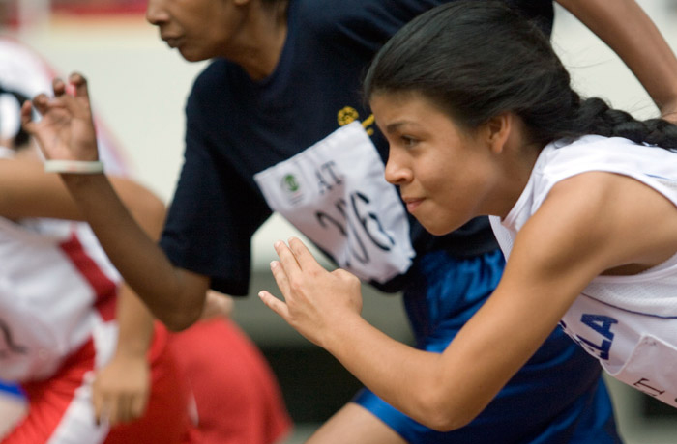
SPORT TEACHES US
Sport teaches us to change our preconceptions and open our minds to real potential.
Sport teaches people who they really are, and we teach people sports. But in the end it’s really they who teach us all.
8

Slide 9

GLOBAL IMPACT
7 Global Regions
228 Local Programs
170+ Countries
1,010,000 Coaches & Volunteers
3,400,000 Athletes
44,000 Events Each Year
World Games Every 2 years
+$4,000,000,000 Raised
9

Slide 10

NORTH AMERICAN IMPACT
79 North American Programs
52 U.S. Programs
573,000 Athletes
547,000 Volunteers
131,000 Families
96,000 Coaches
10

Slide 11
SPECIAL OLYMPICS IN NUMBERS—2009
3.43 million athletes worldwide
8% growth in 2009—fastest growing regions are Asia-Pacific and East Asia
67 percent of our athletes are of school age (8-21)
57,000 individuals in the 2-7 age group
38 PERCENT of the Special Olympics athlete population are female
More than 30 sports, including athletics, football, basketball, bowling, aquatics and table-tennis
130,000 Unified Sports® athletes and over 196,000 partners are now engaged In Unified Sports®
22,177 athletes serve in leadership positions
244,000 coaches supported Special Olympics athletes during 2009
121 competitions were hosted every day in 2009—2.6 million athletes participated
US$173 Million raised (cash) in 2009
11

Slide 12
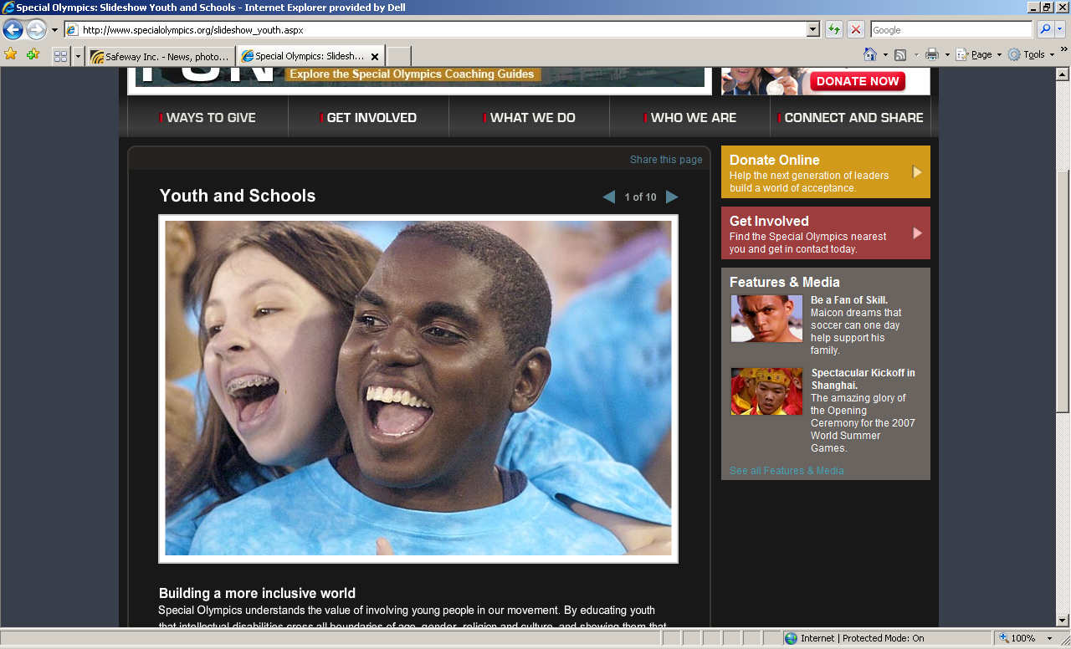
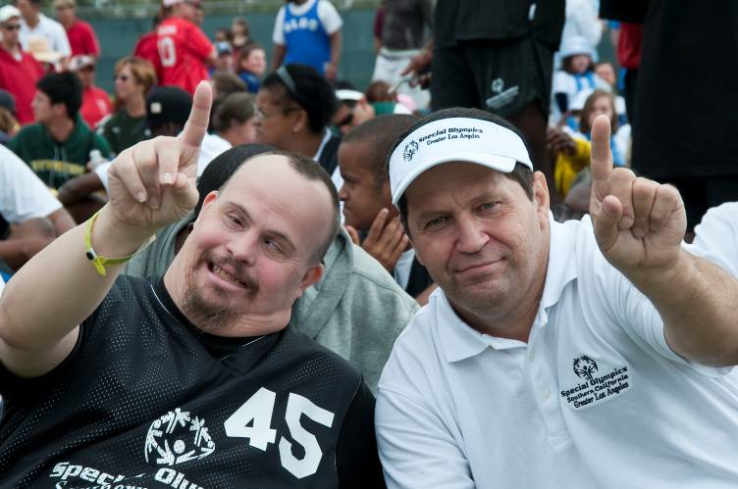
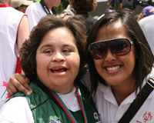
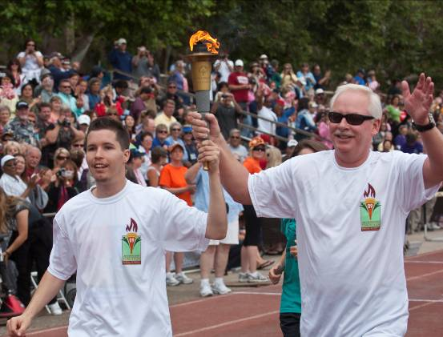
OUR SUPPORTERS
Youth
Parents
Coaches
Donors
Project Unify
Get Into It
Family Support
Networks
Young Athletes
Games
Direct Mail
Web
Volunteering
12

Slide 13













OUR CORPORATE PARTNERS
Sample selection
13

Slide 14
SPECIAL OLYMPICS FRAMEWORK
CHANGE
ATTITUDES
BE A FAN
R WORD
ATHLETE LEADERSHIP
PROGRAMS
EMPOWER
THROUGH SPORTS
UNIFIED
SPORTS
NATIONAL
& WORLD GAMES
YOUNG
ATHLETES
STATE/ PROVINCIAL & LOCAL GAMES
LEAD RESEARCH
INFLUENCING POLICY UNIVERSITY PARTNERSHIPS
BUILD
COMMUNITIES
FAMILY SUPPORT NETWORKS
PROJECT
UNIFY
HEALTHY
ATHLETES
14

Slide 15
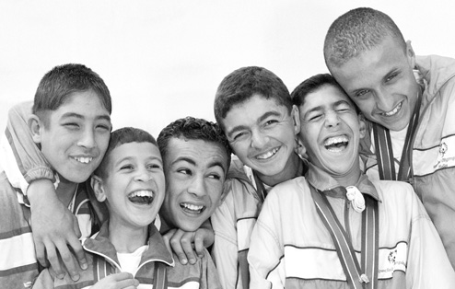
Project Unify®
^{A VISION OF INCLUSION}
15

Slide 16
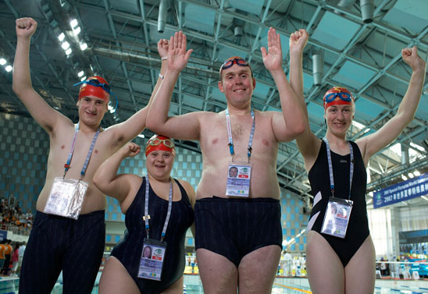
PROJECT UNIFY®
  Time to Think Differently
  Sport for those frequently excluded—people with intellectual disabilities
  Community participation through athlete leadership, Unified Sports®, family empowerment, health promotion, research, advocacy, and volunteerism
  Communicate the gifts and value of every person to audiences around the world
16

Slide 17
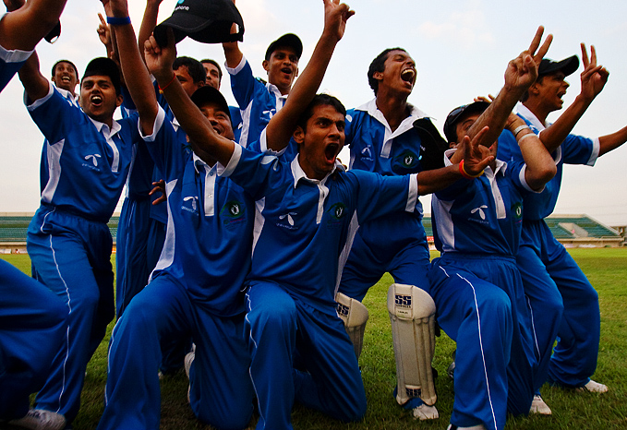
PROJECT UNIFY®
  BUILDING COMMUNITIES
  A strategy to activate youth, engage educators, and promote school communities of acceptance and inclusion where all young people are agents of change.
  Utilizing the sports and education initiatives of Special Olympics, Project UNIFY®:
  Fosters respect and dignity for people with intellectual disabilities
  Changes actions and attitudes among their peers without intellectual disabilities.
17

Slide 18
ISSUES
Public Attitude
70%
of U.S. adults think that children with intellectual disabilities should be taught in a
special school or special class. In Russia it is 90%. And in Brazil it is more than 80%.
SOURCE: Gallup International, 2005
sOCIAL INCLUSION
90%
of youth in the U.S. do not have a classmate with ID.
SOURCE: Siperstein, G. N., Parker, R.C., Norins Bardon, J., & Widaman, K. F. (2007). A National Study of Youth Attitudes toward the Inclusion of Students with Intellectual Disabilities. Exceptional Children, 73, 435-455
Public Attitude
R-word
80%
of children 8-9 years old in the U.S. have heard the r-word used pejoratively.
SOURCE: Gallup International, 2005
18

Slide 19
GOALS
INCLUDE
UNIFY
SPECIAL ED STUDENTS
ALL STUDENTS
ADULT-LED
STUDENT-LED
SPORTS OPPORTUNITIES
sports as a catalyst for SEL
and school climate CHANGE
19

Slide 20

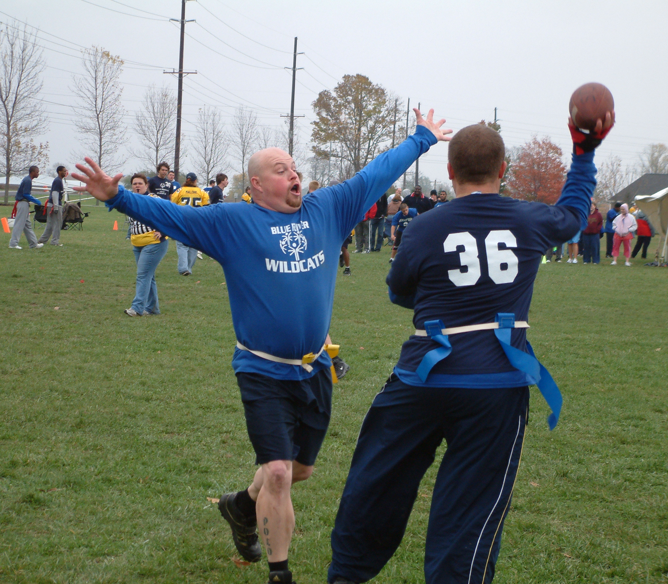
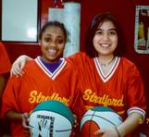

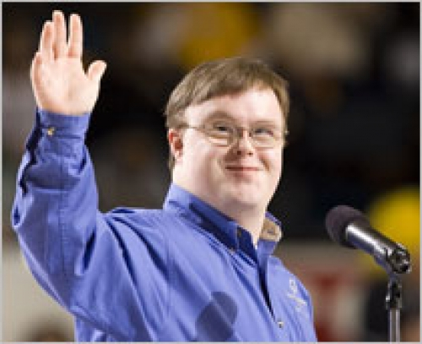
PROJECT UNIFY®: PROGRAM ELEMENTS
Young Athletes™
– early intervention,
social and motor development
Get Into It®
– standards-aligned curriculum
Games and sports events
Unified Sports® teams
R-Word Assemblies
and Rallies for Respect
ALPs – Athlete Leadership/
Inclusive Youth Leadership
20

Slide 21
A WHOLE SCHOOL APPROACH
PRE- K/ELEMENTARY
Young Athletes™, “Get Into It®” curriculum & e-tools, Unify Day, Web site
information/ activities/ friendships, Fans in the Stands, assemblies
MIDDLE SCHOOL
Unified Sports clubs, “Get Into It®” curriculum and e-tools, Youth Summits & rallies,
Unify Day, “R-Word”, Web site connections, essay contests, Fans in the Stands
HIGH SCHOOL
Unified Sports, “Get Into It®” curriculum & e-tools, Unify Day, Games, “R-Word”, web-based friendships, social networking, essay contests, editorial writing, volunteering, Fans in the Stands, assemblies & rallies
21

Slide 22
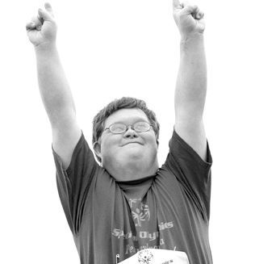
Special Olympics
Get Into It
22

Slide 23
Sponsors:
U.S. Department of Education
Mattel
Ray & Stephanie Lane
Endorsed by:
American Federation of Teachers (AFT)
American Association for Physical Activity and Recreation (AAPAR)
American School Counselor Association (ASCA)
Council of Exceptional Children
Community of Caring
Joseph P. Kennedy Jr. Foundation.
WHAT IS GET INTO IT?
An online resource for teachers to introduce acceptance
A resource downloaded by 40,000 teachers
A Whole school approach:
  Teachers receive standards-aligned, inclusive curriculum (launched to 3 million teachers and administrators)
  Students with and without ID collaborate on projects
  and activities through service-learning and
  experiential-learning
  Serves as complement to other school activities such
  as Spread the Word to End the Word Campaign®, Unified Sports® or Fans in the Stands
23

Slide 24
GET INTO IT IMPACT
“The general education and special education students have learned so much about each other…I see the students hanging
out in the halls together now and having lunch with each other.
It's a win-win situation for everyone.”
Linda Davenport-Kennedy,
Teacher at North High School and Project UNIFY® Coordinator
24

Slide 25
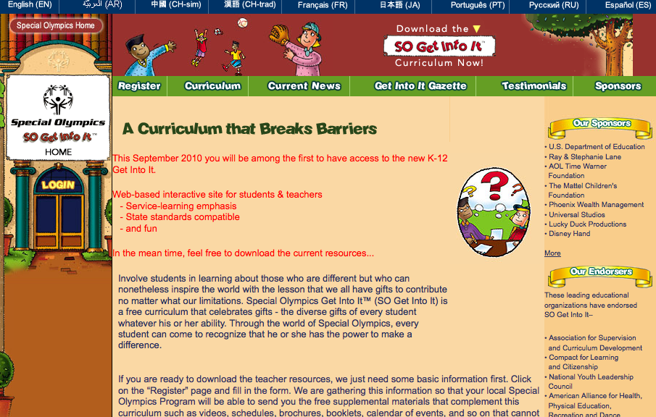
2001 LAUNCH SITE
25

Slide 26
2010 RELAUNCH
The Get Into It interactive, age-appropriate
service-learning curriculum is designed to
advance student’s civic knowledge and
skill development, promote acceptance and understanding of people’s differences to motivate them to become advocates for
and together with all people.
Our new, free K-12 Get Into It resources are available online: www.specialolympics.org/getintoit.
26

Slide 27
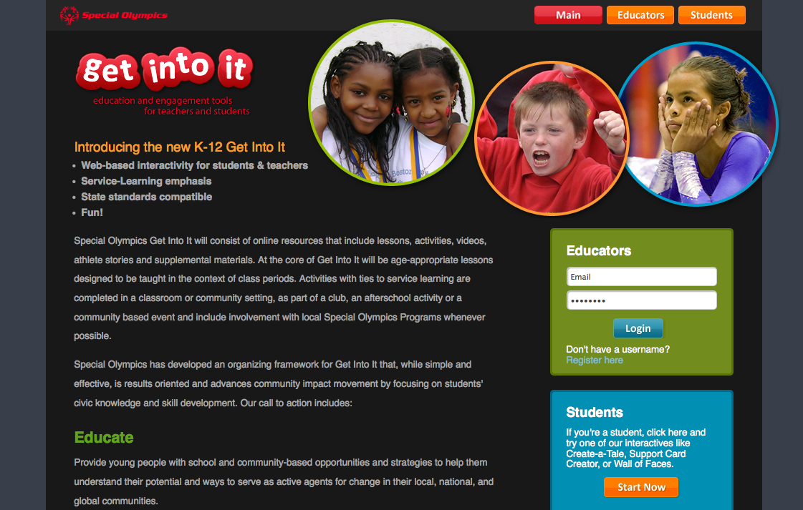
INSERT SCREEN SHOT
27

Slide 28
New & Improved…
Interactive, web-based, standards aligned curriculum with service learning focus
Fun, interactive, creative activities and experiential role plays
Engaging and powerful youth-oriented videos
Inspiring athlete stories
A tool for anti-bullying and teasing campaigns
Lessons compatible with character education
Emphasis on language arts, social studies, health, civics, government, technology,
history and cross curricular extensions
28

Slide 29
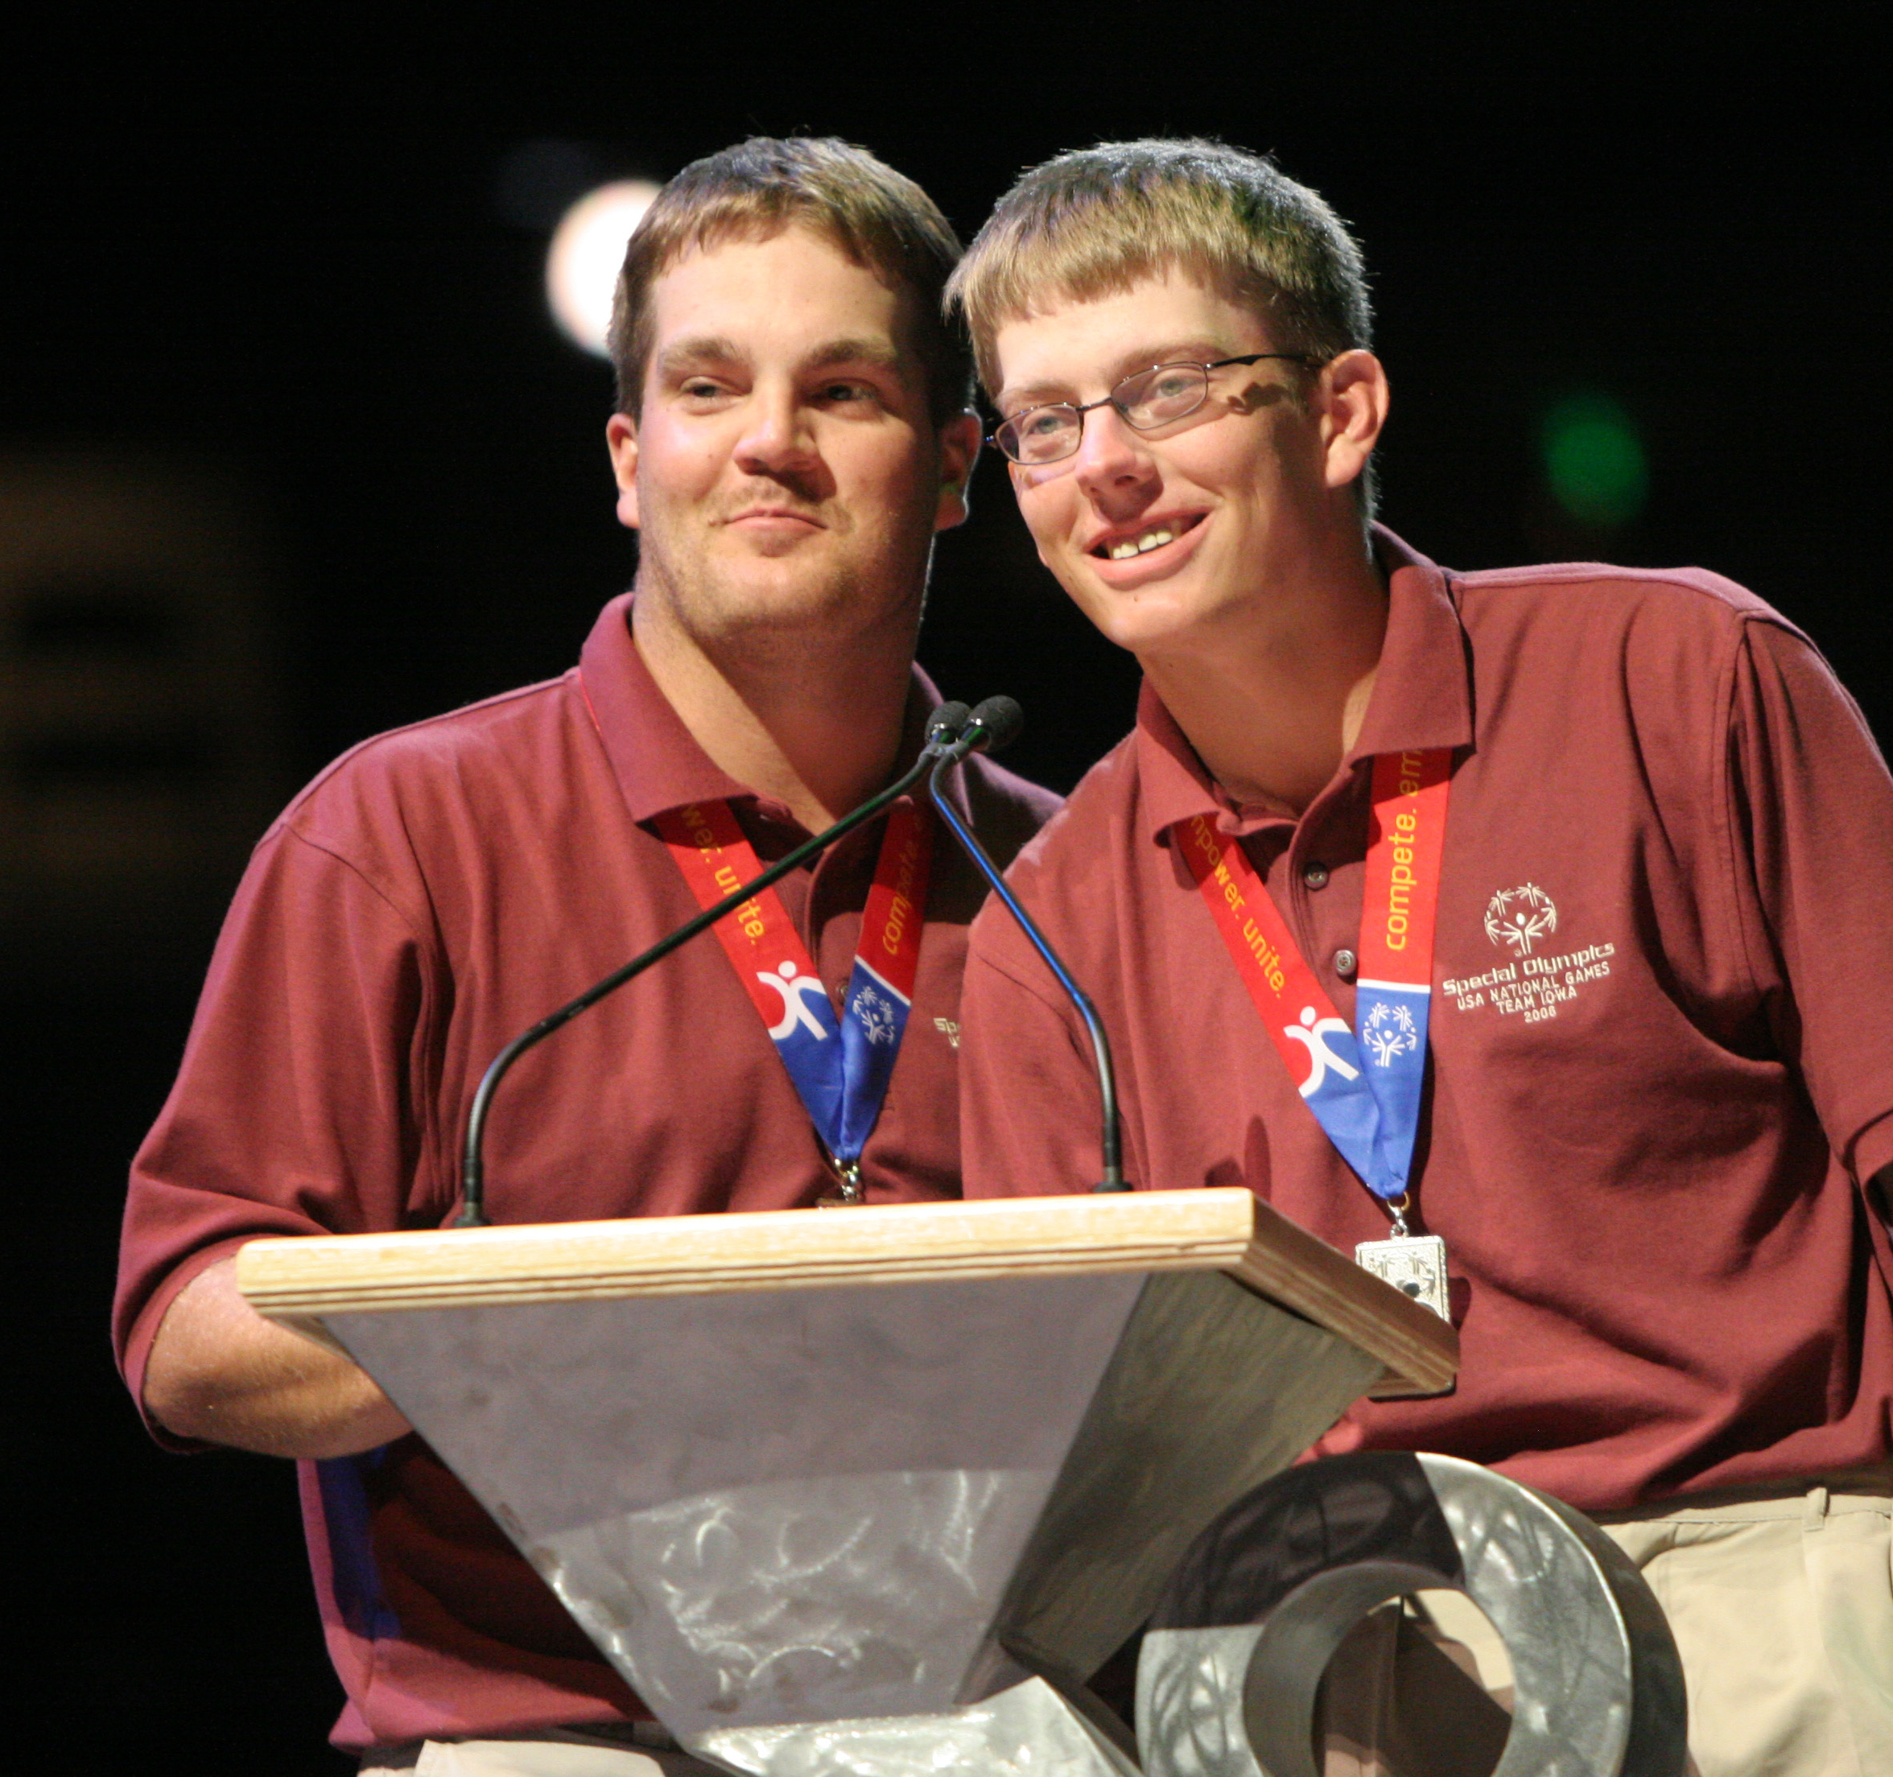
GOALS
Educate, motivate and activate young people to better understand the issue of diversity as it relates to people with intellectual disabilities
Demonstrate the similarities and differences among people with and without intellectual disabilities
Promote better understanding and acceptance of individuals with intellectual disabilities
Foster participation in Special Olympics
Motivate sustainable change among students
and activate them as champions of an important
social movement
29

Slide 30
STRUCTURE
Get Into It is not a curriculum for special education classrooms.
It is a set of resources that educators across all subject areas can use to address their core curriculum requirements, infuse character education into their classrooms, and help implement meaningful service-learning projects that can have a lasting impact among students.
STRUCTURE:
Four distinct units with four self-contained lesson plans
Primary: K-2
Elementary: 3-5
Middle School: 6-8
High School: 9-12
30

Slide 31
CONTENT OVERVIEW
Carries a language arts and social studies focus, but includes options that educators in other curricular areas (e.g., mathematics, health, visual arts, technology) will find useful and relevant.
Written within a service-learning framework so that educators may implement their age-appropriate unit as a means of meeting service-learning requirements.
Topics:
Self Identity
Character Education
The prevalence of the R-word in popular culture
The perseverance demonstrated by Special Olympics athletes
31

Slide 32
TYPES OF STUDENT ACTIVITIES
Self-reflecting on their own attitudes and behaviors toward those with intellectual disabilities
Evaluating levels of tolerance and inclusion within their school and community
Developing and delivering messages of support to athletes
Creating a product that models inclusion and acceptance
Involvement in the Special Olympics movement
32

Slide 33
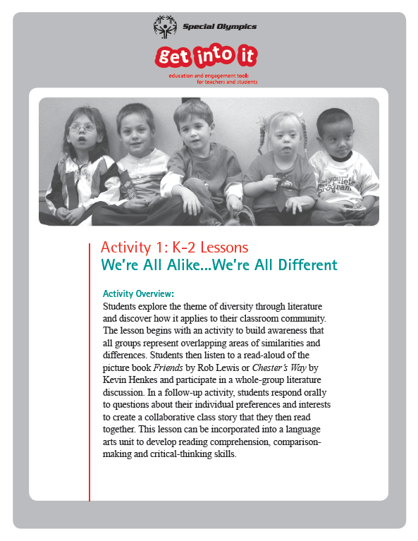
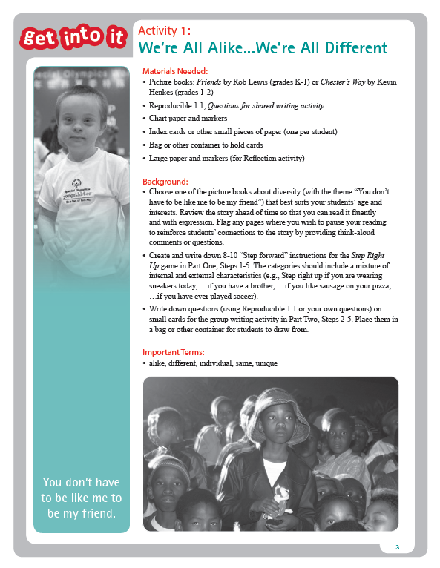
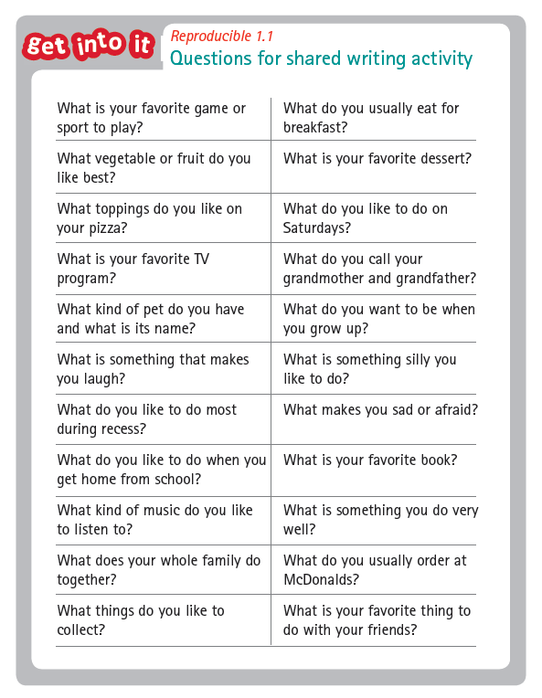
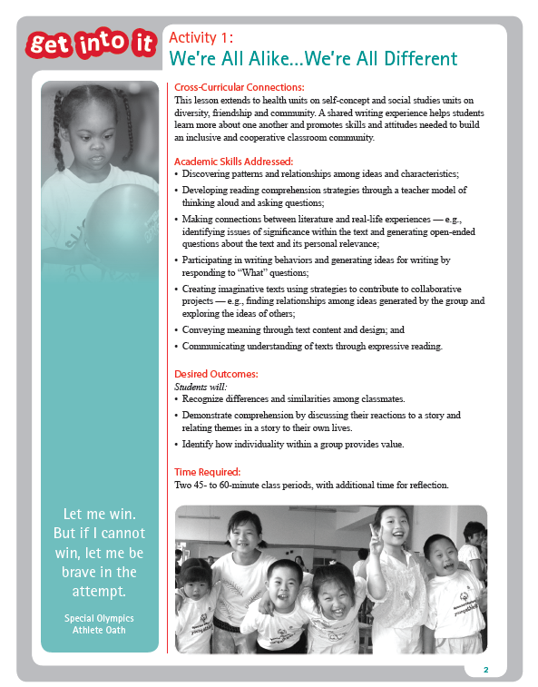
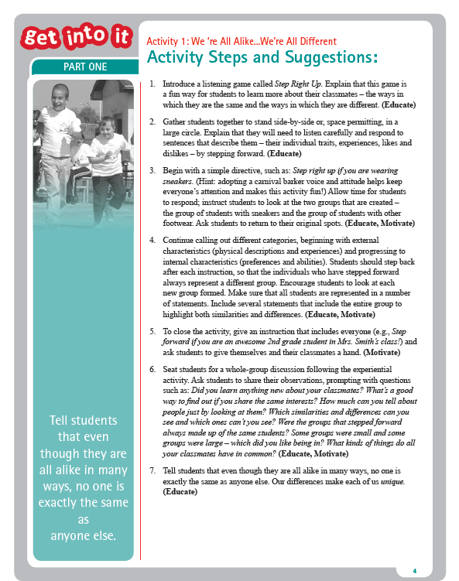
SAMPLE LESSON PLAN
33

Slide 34
SERVICE-LEARNING
Students who participated in service-learning activities in high school:
—were 22 percent more likely to graduate from college than those who did not participate.
—Scored 6.7 percent higher in reading achievement and 5.9 percent higher in science achievement than those who did not participate in service-learning.
Service-learning is a powerful teaching strategy that increases academic achievement, civic engagement and is even a potential dropout prevention strategy. Get Into It was developed within a service-learning framework. The curriculum leads logically to student involvement in service-learning experiences that directly and indirectly impact Special Olympics.
34

Slide 35
SERVICE-LEARNING
Get Into It allows students to participate in a worthwhile opportunity that has direct impact in the community in which they live and learn.
GET INTO IT (SERVICE-LEARNING)
UNIFIED
SPORTS®
VOLUNTEERISM AT GAMES & COMPETITIONS
INVOLVEMENT IN GRASSROOTS ACTIVITIES LIKE POLAR PLUNGE
DEVELOPMENT OF NEW SPECIAL OLYMPICS PROGRAMS
35

Slide 36
HOW TO ACCESS
The Get Into It curriculum is online at: www.specialolympics.org/getintoit
Using an online method of delivery, we:
  Reduce our production costs
  Enable ongoing updates more easily
  Foster a collaborative environment among the educators who are using the curriculum
CREATE AN ACCOUNT
Grants access to the curriculum and related multimedia content
Provide links to the student portal
Enable participation in an online community of educators using the resources
36

Slide 37
WHAT TEACHERS ARE SAYING ABOUT GET INTO IT
Nearly 90% rated the curriculum as either “excellent or good.”
Overwhelmingly positive in rating the relevance of curriculum activities to students’ lives.
Every teacher (surveyed) planned to use the curriculum in the future.
Most agreed they could prepare curriculum materials in a reasonable amount
of time.
All teachers and administrators agreed that curriculum activities were clear, thorough, meet the needs of inclusive classrooms and meet appropriate state education standards.
37
Notes:
Data from the 2010 Evaluation Report. The key findings are based on survey data generated from 16 teachers, 8 administrators, and 194 students in Michigan, Missouri, and North Carolina.

Slide 38
WHAT STUDENTS ARE SAYING ABOUT GET INTO IT
87% of students indicated they had made an effort to reduce incidents of intolerant behavior toward students with intellectual disabilities.
Nearly 85% of students responded that the curriculum changed what they thought about persons with intellectual disabilities.
More than 90% of students reported the curriculum provided them with a clear understanding of how to get involved with Special Olympics in their community.
90% of students indicated the SOGII curriculum would make them more likely to get involved with Special Olympics.
38
Notes:
Data from the 2010 Evaluation Report. The key findings are based on survey data generated from 16 teachers, 8 administrators, and 194 students in Michigan, Missouri, and North Carolina.

Slide 39
THE OPPORTUNITY FOR YOUR SCHOOL
Celebrate the gifts of every student whatever his or her ability
Participation offers your school and classroom an opportunity to:
Access free, simple, accessible, and results-oriented new resources
Help address many academic goals and priorities
Support character education and promote student leadership
Involve students in meaningful service-learning experiences in the school
and community
Teach tolerance, promote anti-bullying and change students’ attitudes and behaviors toward individuals with intellectual disabilities
39

Slide 40
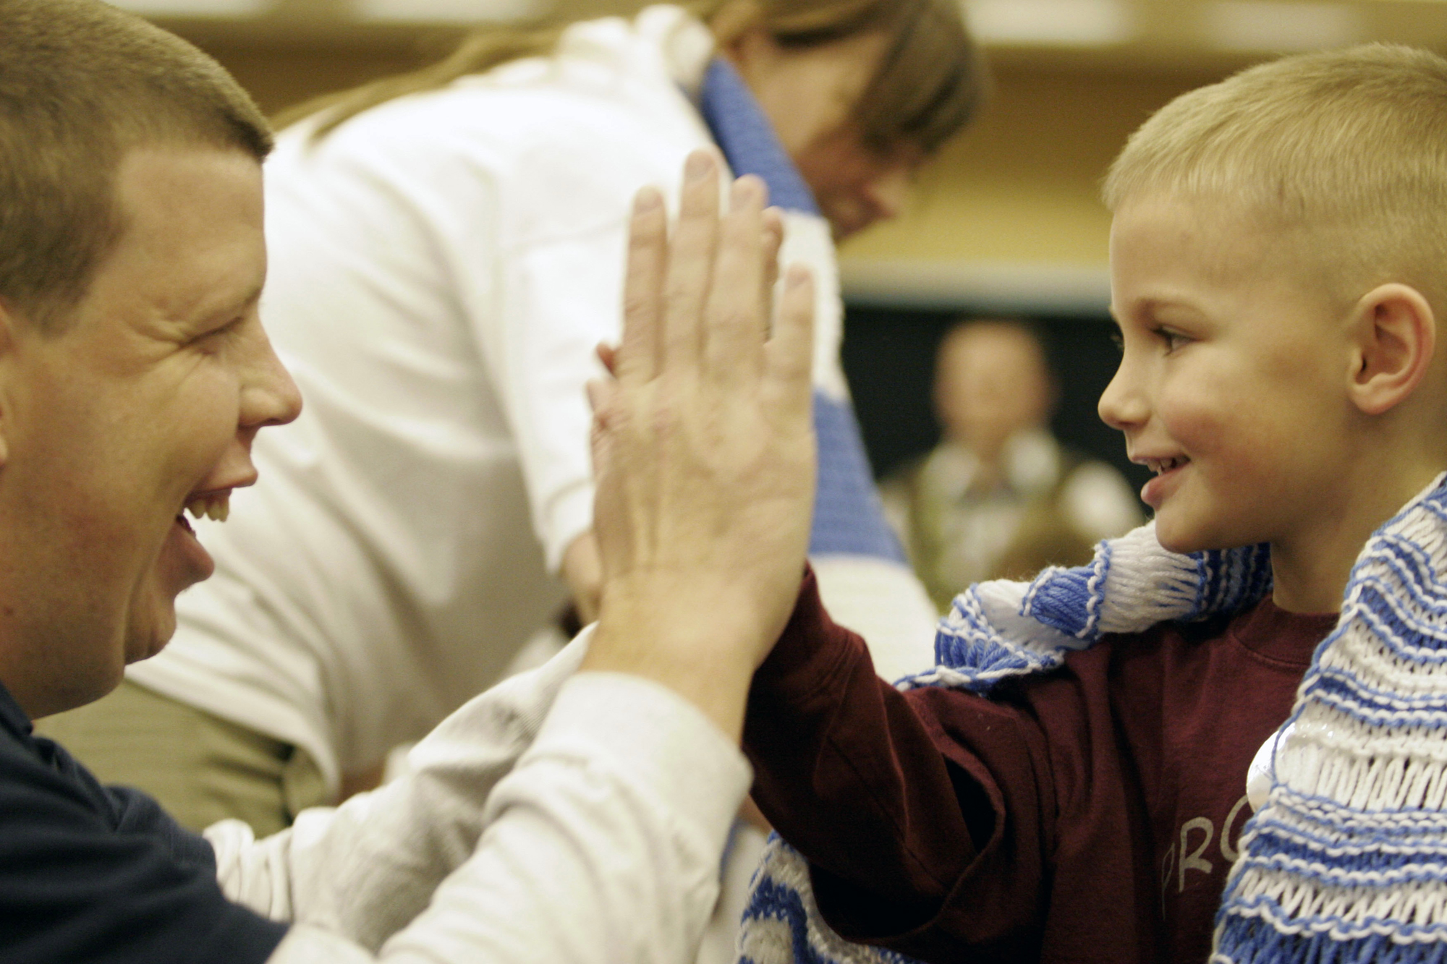
THE OPPORTUNITY FOR YOUR PROGRAM
Participation offers your Program
an opportunity to:
Establish and nurture relationships among schools, educators and the greater community
Get recognition for the positive impact that Get Into It can have on youth attitudes and behaviors toward individuals with intellectual disabilities
Foster greater interest in the Special Olympics organization in general, and open the door to a potential pool of new volunteers, donors, and athletes
40

Slide 41
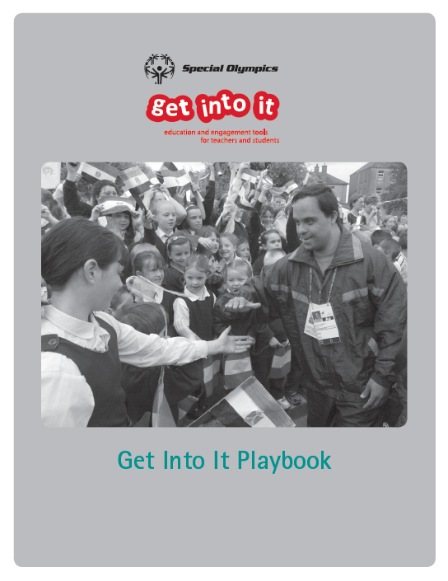
PLAY BOOK— A RESOURCE FOR PROGRAMS
Provides:
Background information about the curriculum
An explanation of the importance of gaining traction for the curriculum among the local education community
Tips and suggestions for engaging the local education community and leveraging community partnerships
Marketing resources and templates that help you communicate effectively with the target audience and build
awareness around the curriculum
Contact information for Special Olympics representatives who can answer additional questions
41

Slide 42
TESTIMONIALS
“The students enjoyed learning more about students with special needs. They were able to connect and develop a better understanding of students within our school.”
“I think that this curriculum was extremely helpful in addressing a wide variety of issues. We were able to tie in character education, Spread the Word to End the Word, and diversity acceptance based on the Get Into it curriculum.”
Guidance Counselor, Irwin Elementary School, NC
42

Slide 43
TESTIMONIALS
“I teach Leadership Development to my high school’s student government officers. This curriculum will definitely make them realize they represent a broad range of students, not just their cliques.”
“My class officers served as volunteers at SO for the first time this year. That will definitely be an ongoing service they perform. They
had a BLAST.”
Science Teacher, Cape Fear High, NC
43

Slide 44
TESTIMONIALS
“Now, I don’t think of them as different; I think of them as just another one of my friends.”
Katerina Kanagalingam,
student at Cedar Valley Middle School, TX
44

Slide 45

THANK YOU
for your support of our vision

Slide 46
JENNIFER NEWBURY
Curriculum & Education Resource Manager,
Special Olympics
(202) 824-0282
jnewbury@specialolympics.org
Get Into It educator and student portal:
www.specialolympics.org/getintoit

